Slide 1
Classification of White Blood Cells for Identification of AML and ALL
ST445 Final Project

Slide 2
Biological Context: What are AML and ALL?

Slide 3
Leukemia
Leukemia–cancers that affect tissues responsible for formation of blood cells → abnormal blood cells
  Crowd out healthy cells, increasing risk of infection and anemia
Four main types:
  Chronic myelogenous (CML)
  Chronic lymphocytic (CLL)
  Acute myelogenous (AML)
  Acute lymphocytic (ALL)
Affects myeloblasts
Affects lymphoblasts
Notes:
Types of leukemia differ based on the cells that they affect; chronic leukemias tend to affect cells in later stages of their development, meaning those cells are more mature and better able to perform their normal function. As such, chronic leukemias are often considered less serious than acute leukemias.

Slide 4
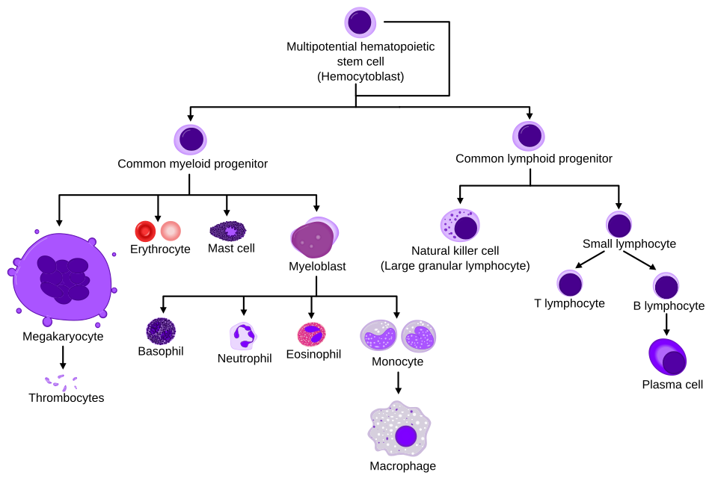
Types of Blood Cells
Notes:
Types of blood cells are typically identified using the shape of the nucleus (or lack thereof) and whether or not the cytoplasm is granular.

Slide 5
AML and ALL
Symptoms (Puckett & Chan, 2023)
  Asymptomatic patients
  Anemia, thrombocytopenia, and neutropenia
  Fever, night sweats, weight loss
Prognoses
  Prognosis worsens as a patient’s age increases
  Untreated AML leads to death within weeks to months of clinical presentation (Shipley & Butera, 2009)
  Five-year survival rates (Roswell Park Comprehensive Cancer Center, n.d.)
    AML: 31.9%
    ALL: 72%
Notes:
Many patients are asymptomatic and are only diagnosed after high levels (>=20%) of blasts are found during routine bloodwork. Furthermore, certain symptoms are often mild and can be misdiagnosed as they are nonspecific to AML and ALL. Diagnosis is determined using the percentage of blasts in the peripheral blood or bone marrow. Anemia is low levels of red blood cells, thrombocytopenia is low level of platelets, and neutropenia is low levels of neutrophils. The occurrence of blasts cause the presentation of fever, night sweats, and weight loss. The prognosis depends heavily on age of patient; the younger (and generally stronger) the patient, the more intense chemotherapy they can undergo. Especially for AML, chemotherapy is critical and is the standard treatment. ALL accounts for 80% of acute leukemia cases in childhood cancer, while only accounting for 20% of that in adult cases. This may be why the ALL survival rates are higher (younger patients).

Slide 6
Dataset

Slide 7
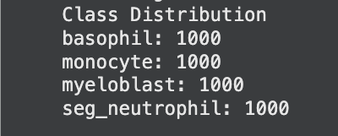
Blood Cell Images for Cancer Detection
Uploaded by Sumith Singh Kothwal
Images collected under standardized conditions
Notes:
Directories included in the dataset: basophils, erythroblasts, monocytes, myeloblasts, and segmented neutrophils. We chose to remove the erythroblast directory, as they form into red blood cells and are therefore unimportant to our model. It should also be noted that analysis was performed under the impression that the “myeloblast” directory actually included myeloblasts and lymphoblasts, as was inferred from the “About the Dataset” section. Upon analysis, some cells certainly had characteristics more distinctive of lymphoblasts than myeloblasts.

Slide 8
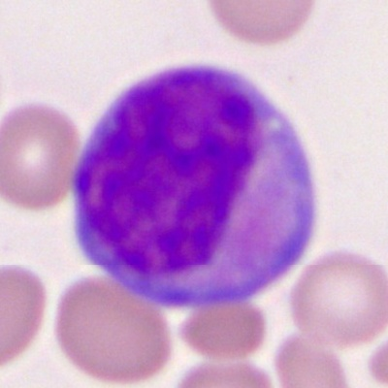
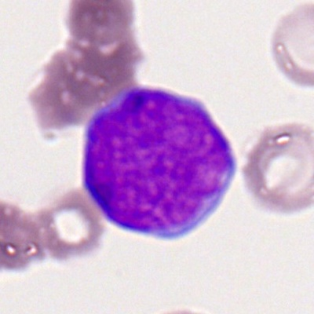
Myeloblasts vs. Lymphoblasts
Suspected myeloblast
Suspected lymphoblast
Notes:
Inspection of the “myeloblast” directory seemingly supports the assumption that lymphoblasts are included. The small amount of cytoplasm in the right image is characteristic of a lymphoblast. That said, it should be noted that oftentimes flow cytometry is used to definitively differentiate between the two types, and even visual appearances can be deceiving, especially for those not trained for such a task. Images provided in the data set are blurry, potentially negatively impacting the model performance.

Slide 9
Image Preprocessing

Slide 10
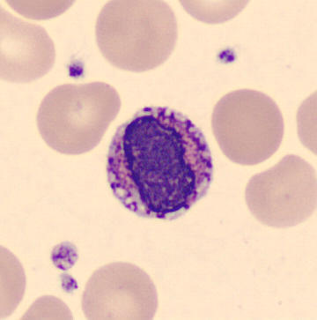
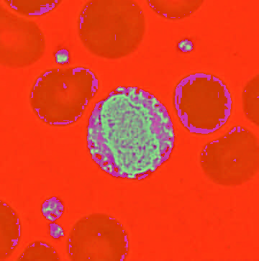
Preprocessing Biological Images
Difficulties associated with bioimages
Preprocessing pipelines based on previous literature
  Multinomial model: Gaussian blur → HSV → masking → Canny edge detection → resizing
  CNN model: HSV → masking → resizing
Image in RGB
Image in HSV
Notes:
Difficulties associated with bioimages include noise, varying light intensity, low resolution, blur, and overlapping targets. This can make image processing hard on even state-of-the-art machines, underscoring the importance of preprocessing. Pipelines were based on previous literature and their applicability to our dataset. Our goal was to emphasize the shape (and for CNN, the texture) of the nucleus, as that is one of the most distinguishing factors used when identifying blood cells by hand. Edge detection was reserved for the multinomial model only, as CNN should be able to detect edges and shapes itself. As recommended by the documentation, a Gaussian blur was applied prior to edge detection to reduce noise. Conversion to HSV is recommended for biological pictures, and we masked to only include HSV values associated with the nucleus.

Slide 11
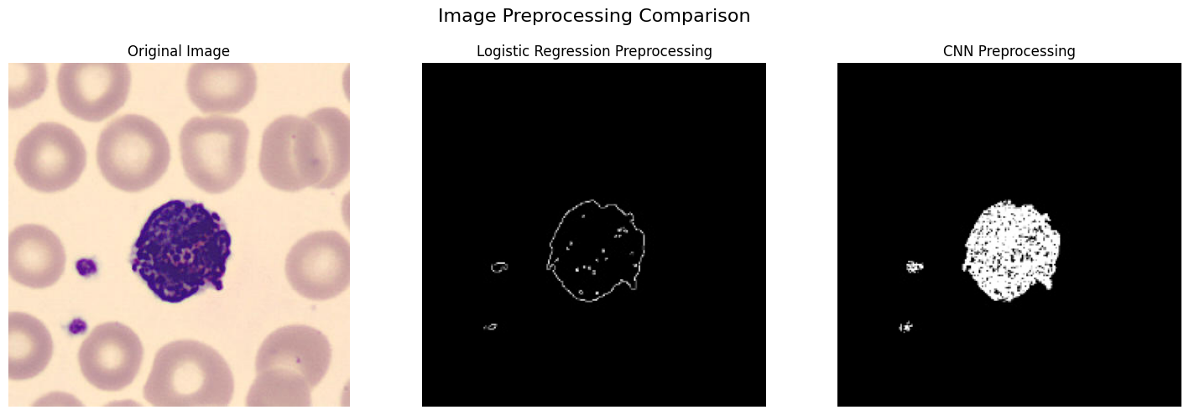
Visualizing Image Preprocessing
Notes:
Nucleus is dark purple; cytoplasm is the light purple (not very apparent here). Preprocessing has washed out the red blood cells (not pertinent) and outlined the nucleus.

Slide 12
Multinomial Model

Slide 13
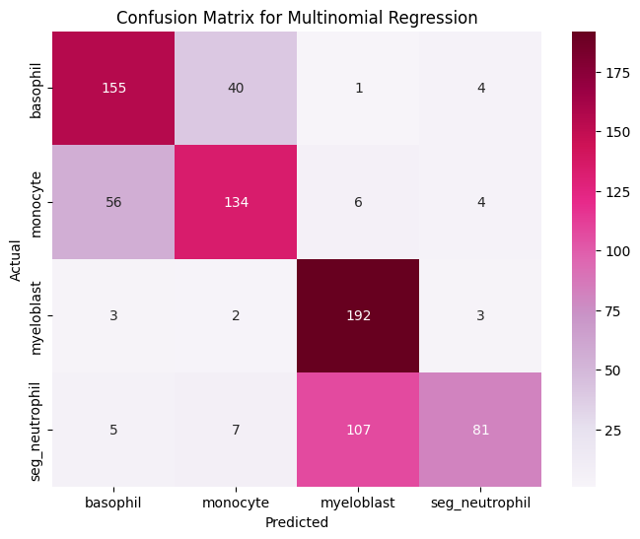
Classification Matrix for Multinomial Model
Tuning of 1/α (L2)
Achieved an accuracy of 70.1%
Myeloblast recall of 0.96, which is critical for ALL and AML detection
Notes:
The multinomial model was done using scikitlearn in Python. L2 regularization was utilized, so hyperparameter tuning was used for 1/⍺. The model was most likely to confuse basophils with monocytes (and vice versa) and myeloblasts with segmented neutrophils (and vice versa). Although this model produces false positives (giving it the lowest precision score), which would cause unnecessary stress in patients, it accurately identified 192 out of the 200 total neutrophils in the test data, giving it a very high recall score. This recall score is the highest out off all categories, which is ideal for our model as it emphasizes the detection of cancerous cells over the classification of healthy cells.

Slide 14
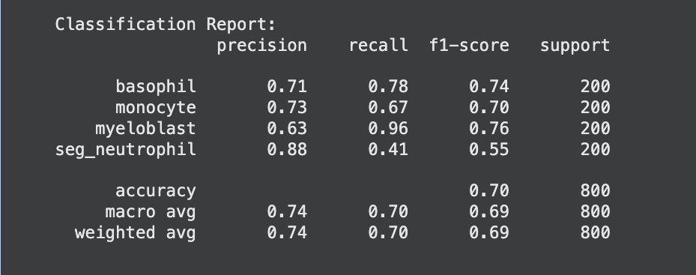
Classification Report for Multinomial Model
Notes:
Precision = actual positive instances / predicted positive instances → most precise is segmented neutrophil
Recall = predicted positive instances / actual positive instances → highest recall is myeloblast
F1-score = mean of precision and recall
Accuracy = number of correct predictions / total number of predictions

Slide 15
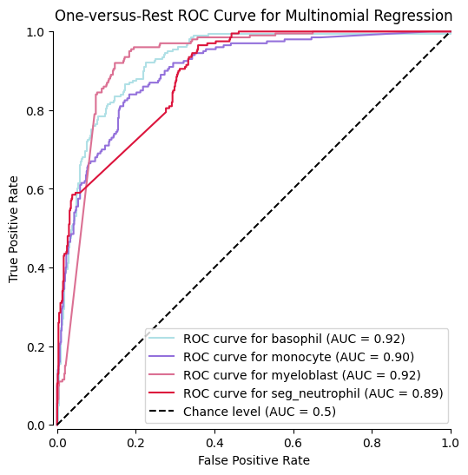
ROC Curve for Multinomial Model
Overall AUC score of 0.86
  Basophil AUC score: 0.92
  Monocyte AUC score: 0.90
  Myeloblast AUC score: 0.92
  Neutrophil AUC score: 0.89
Notes:
ROC curve uses one-versus-rest criterion, where each category is compared against the aggregate of the remaining categories. Macro-averaging was used in its calculation, as all classes were represented equally in the data.

Slide 16
Convolutional Neural Network (CNN) Model

Slide 17
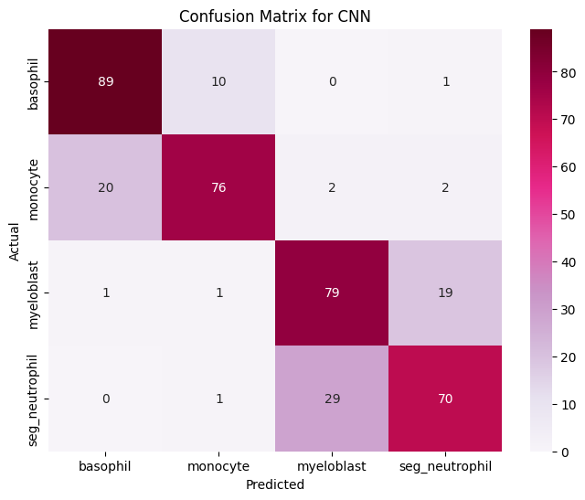
Classification Matrix for CNN Model
Hyperparameter tuning with 10 epochs to optimize layer sizes, dropout rate, and activation functions
Training over 10 epochs
Achieved an accuracy of 79%, up from 70.1%
Notes:
Hyperparameter tuning was used to identify the best: number of neurons for each convolutional layer of the network, the number of neurons in the dense layer of the network, the dropout rate (portion of the neurons that are ”silenced” in order to improve generalizability, and activation function (ReLu vs. tanh). The model was then trained over 10 epochs. The final model had three convolutional layers, each followed by a pooling layer, and two dense layers separated by the dropout. The accuracy of the CNN model was roughly 10% better than that of the multinomial model. The confusion between basophils and monocytes was somewhat lessened. There is still some confusion between myeloblasts and segmented neutrophils, but this model is more likely to correctly identify the neutrophils. This came at the cost of a decreased recall for myeloblasts.

Slide 18
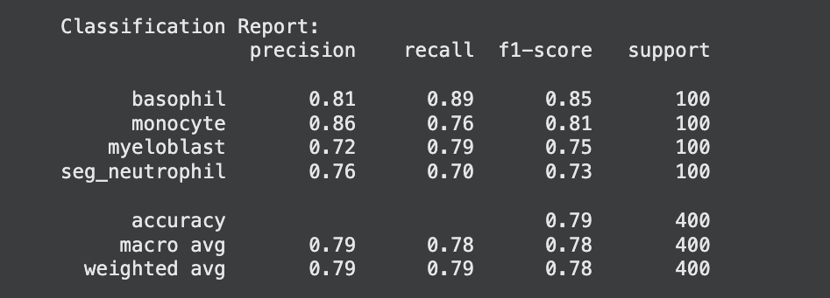
Classification Report for CNN Model
Notes:
Precision = actual positive instances / predicted positive instances → most precise is monocyte
Recall = predicted positive instances / actual positive instances → highest recall is basophil
F1-score = mean of precision and recall
Accuracy = number of correct predictions / total number of predictions

Slide 19
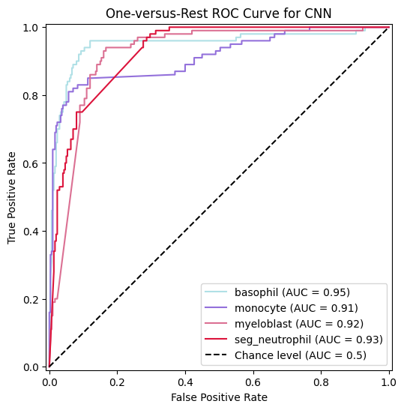
ROC Curve for CNN Model
Overall AUC score: 0.93
  Basophil AUC score: 0.95
  Monocyte AUC score: 0.91
  Myeloblast AUC score: 0.92
  Neutrophil AUC score: 0.93
Notes:
ROC curve uses one-versus-rest criterion, where each category is compared against the aggregate of the remaining categories. Macro-averaging was used in its calculation, as all classes were represented equally in the data.

Slide 20
Web Application

Slide 21
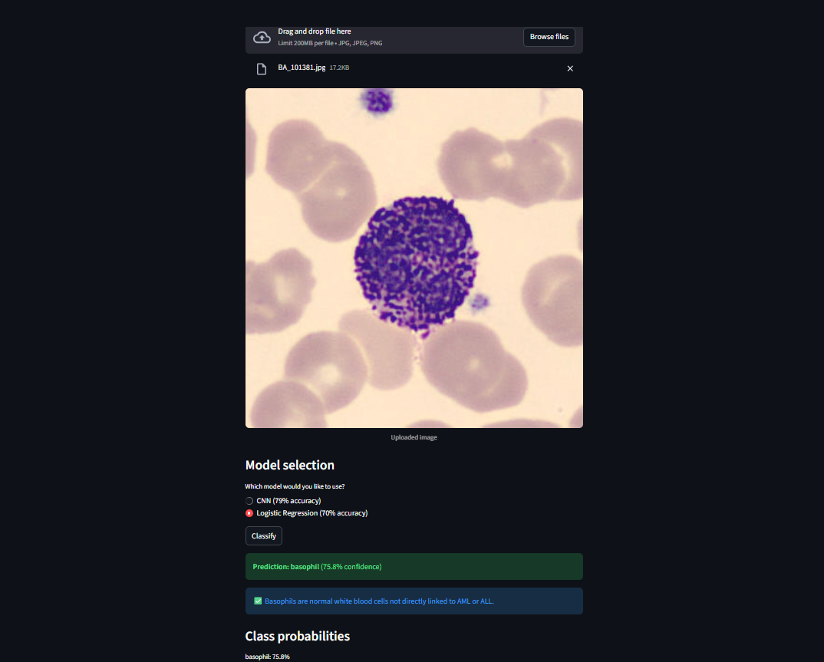
Classifier
Submit a white blood cell smear and use either model to predict whether the cell is healthy, or not.

Slide 22
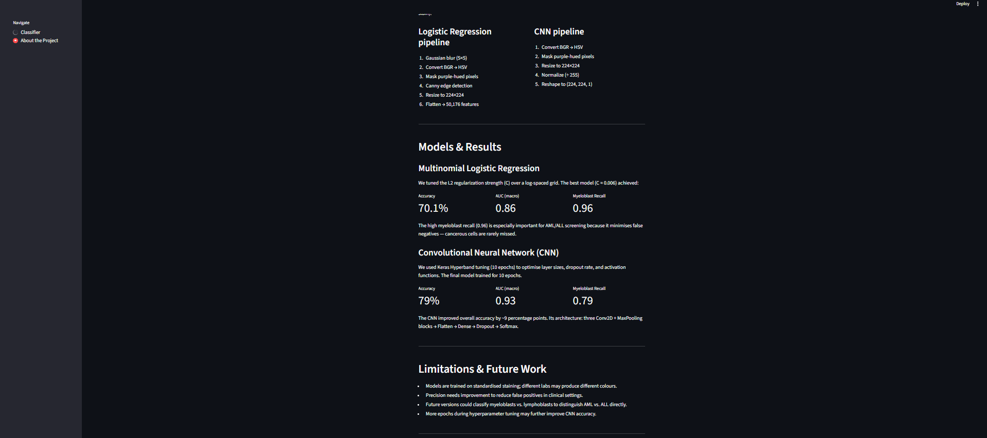
About the Project
Information about the project and approximate model results

Slide 23
Industry Use and Impact

Slide 24
Potential Model Applications
The CNN model may be utilized by oncologists to diagnose ALL and AML at an earlier stage, thereby enabling timely treatment and potentially enhancing survival rates among patients.
Additionally, oncologists may employ multinomial regression as a validation tool to identify or mitigate false negatives if deemed necessary.

Slide 25
Model Limitations
Both models are trained using blood smears imaged at standardized conditions; alterations to the staining and microscope procedure could alter the appearance of cells under the microscope.
Although high recall means that truly cancerous cells are identified at a high rate, the precision for both models would need to be increased in order to minimize false positives.
Future models can be designed to differentiate between myeloblasts and lymphoblasts.
  Increased number of epochs for hyperparameter tuning and training can improve accuracy

Slide 26
References
Puckett, Y., Chan, O. (2023). Acute lymphocytic leukemia. StatsPearls. https://europepmc.org/article/nbk/nbk459149.
Roswell Park Comprehensive Cancer Center. (n.d.). Leukemia survival rates. https://www.roswellpark.org/cancer/leukemia/survival-rates
Shipley, J.L., Butera, J. N. (2009). Acute myelogenous leukemia. Experimental Hematology, 37(6), 649-658. https://doi.org/10.1016/j.exphem.2009.04.002.
Uchida, S. (2013). Image processing and recognition for biological images. Development, Growth & Differentiation, 55(4), 523–549. https://doi.org/10.1111/dgd.12054.

